Slide 1
Streaming Service Data Analysis and Strategy Recommendations
BA472 Course Project

Slide 2

Presentation Overview
01
02
03
04
05
06
Introduction
Data Preparation
Research Questions
Experiments
Key Findings & Recommendations
Questions?

Slide 3
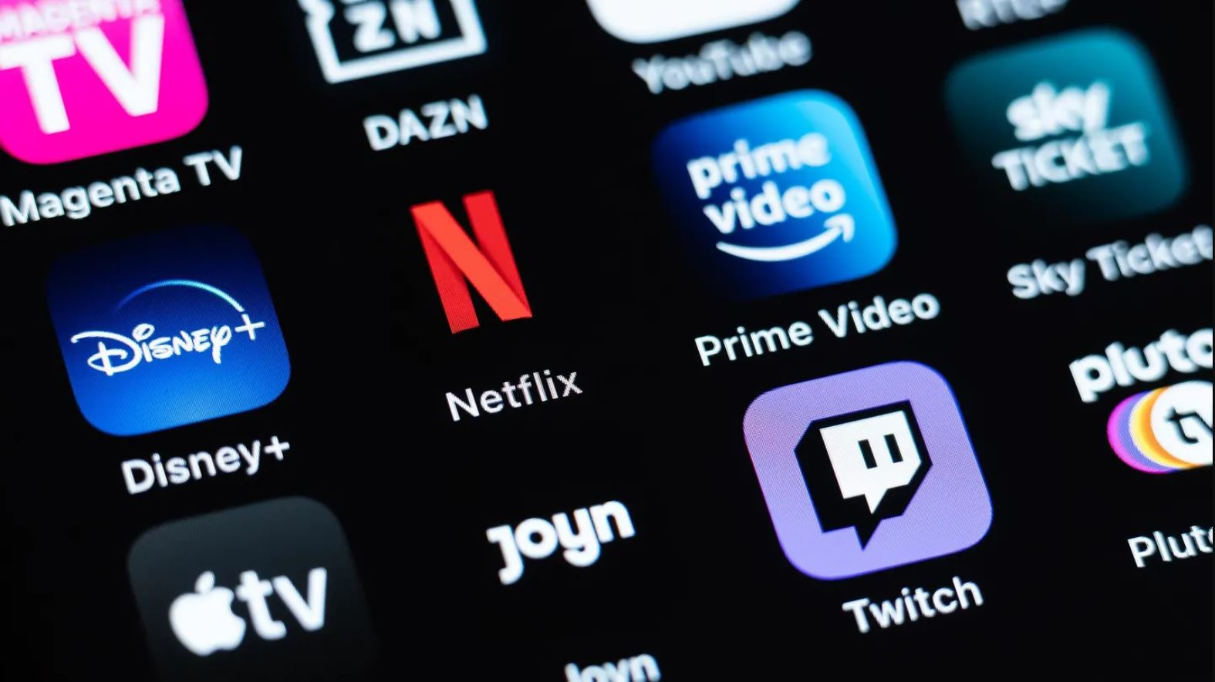
01
Introduction

Slide 4
Company Overview
We are a research team at a new media streaming platform called CineFlix
CineFlix has built up a great library of content, and now is looking for the best ways to drive revenue growth by attract new customers.
Our team collected a data set involving customer demographics, service usage, and plan options to analyze.
Now we look to answer the question:
How can we extract insights from our streaming trial data set and apply them to inform the strategy of the entire company?

Slide 5


The Problem: Entering a Saturated Streaming Market
Our streaming platform must quickly build an effective strategy to attract customers in a fast evolving industry.
Many established players with leading brand already control a large market share.
Including Disney+, Netflix, Hulu, HBO Max, Prime Video
Customers are fatigued by the number of streaming options, new content releases, and plan types.
This poses a challenge as well as an opportunity for a newer, more customer-centered streaming service to enter the market.

Slide 6
Finding Measures of Customer Satisfaction
We are focused on improving customer retention → customer satisfaction
More satisfied = more likely to become a paying customer following their trial
What variables in our data set indicate positive or negative customer satisfaction?
Hours Streamed
User Satisfaction Score
Renewal After Trial
What do we have control over to drive customer satisfaction?
Monthly Subscription Cost*
Subscription Type*
Duration of Free Trial

Slide 7
02
Data Preparation

Slide 8
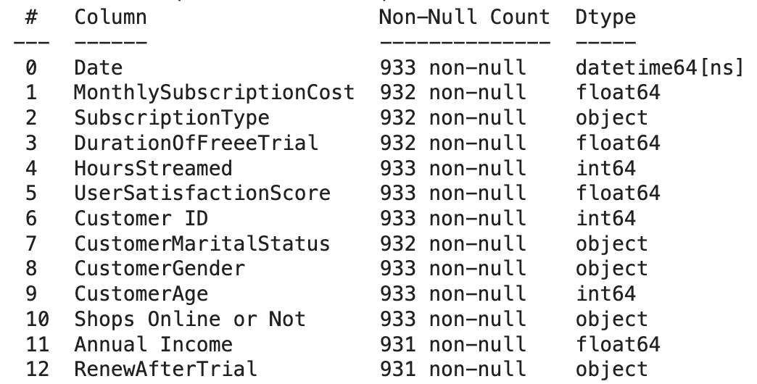
Our Raw Data Post-Collection
13 attributes
Null values found in 6 attributes
Includes numeric and categorical variables
Necessitated dummying in next stage of data transformation

Slide 9
Data Transformation
Data Cleaning
Variable Analysis
Forming Questions
Dummy Variables
Removed null values
Checked for duplicate records
Determined variable types and ranges
Renamed variables for uniformity
Selected treatment & response variables
Formed 6 research questions
Subscription Type: ads or no ads
Shops Online or Not: no or yes
Renew After Trial: no or yes
Duration of Free Trial: <=10 days, >10 days
Duration of Free Trial
Short Trial: <= 10 days | 435
Long Trial: > 10 days *up to 14 days longest trial option | 490

Slide 10
03
Research Questions

Slide 11
Variables in Our Tests
Treatment Variables
Performance Measures
Covariates Used
Subscription Type (Ads v No Ads)
Duration of Free Trial (Short v Long)
Hours Streamed
User Satisfaction Score
Renewal Status
Customer Age
Shops Online or Not
Annual Income

Slide 12
Treatment Variable:
Subscription Type
How does Subscription Type influence Hours Streamed?
How does including ads in a user’s subscription impact hours streamed?
Less → viewer annoyance
More → ads increase stream time
How does Subscription Type influence User Satisfaction Score?
Does reducing ads result in higher user satisfaction?
How does Subscription Type influence Renewal Status?
Does including ads reduce user conversion post-trial?
Why We Care → We want to see if CineFlix should be reducing ads

Slide 13
Treatment Variable:
Duration of Free Trial
How does Duration of Free Trial influence Hours Streamed?
Does a longer trial lead to users streaming more?
How does Duration of Free Trial influence User Satisfaction Score?
Does a longer trial lead to users being more satisfied with their experience?
How does Duration of Free Trial influence Renewal Status?
Does a longer trial result in more users renewing with CineFlix?
Why We Care → We want to see if CineFlix users respond better to a shorter or longer trial

Slide 14
04
Experiments

Slide 15
Hypothesis Test on Means
1. How does Subscription Type influence Hours Streamed?
Mean hours streamed for subscription type with ads = 36.77 hours
Mean hours streamed for subscription type without ads = 38.26 hours
P-Value = .1365
Insight: Removal of ads actually increases hours streamed
2. How does Subscription Type influence User Satisfaction Score?
Mean user satisfaction score for subscription type with ads = 4.36
Mean user satisfaction score for subscription type without ads = 4.41
P-Value = .1979
Insight: Removal of ads leads to a higher satisfaction score

Slide 16
Hypothesis Test on Means
3. How does Duration of Free Trial influence Hours Streamed?
Mean hours streamed for short trial = 30.01 hours
Mean hours streamed for long trial = 43.68 hours
P-Value = 0.00
Insight: confirms that people with longer duration trials are utilizing the platform while they have access
4. How does Duration of Free Trial influence User Satisfaction Score?
Mean user satisfaction score for short trial = 4.34
Mean user satisfaction score for long trial = 4.40
P-Value = 0.09
Insight: users with longer duration trials have higher satisfaction scores post-trial on average

Slide 17
Hypothesis Test on Proportions
5. How does Subscription Type influence Renewal Status?
Conversion rate for subscription type with ads = 65.18%
Conversion rate for subscription type without ads= 66.22%
P-Value = 0.7545
Insight: Removing ads does not have an impact on trial renewal rate
6. How does Duration of Free Trial influence Renewal Status?
Conversion rate for short trial = 54.25%
Conversion rate for long trial = 75.51%
P-Value = 0.00
Insight: Users with a longer duration of free trial are much more likely to renew after the trial

Slide 18
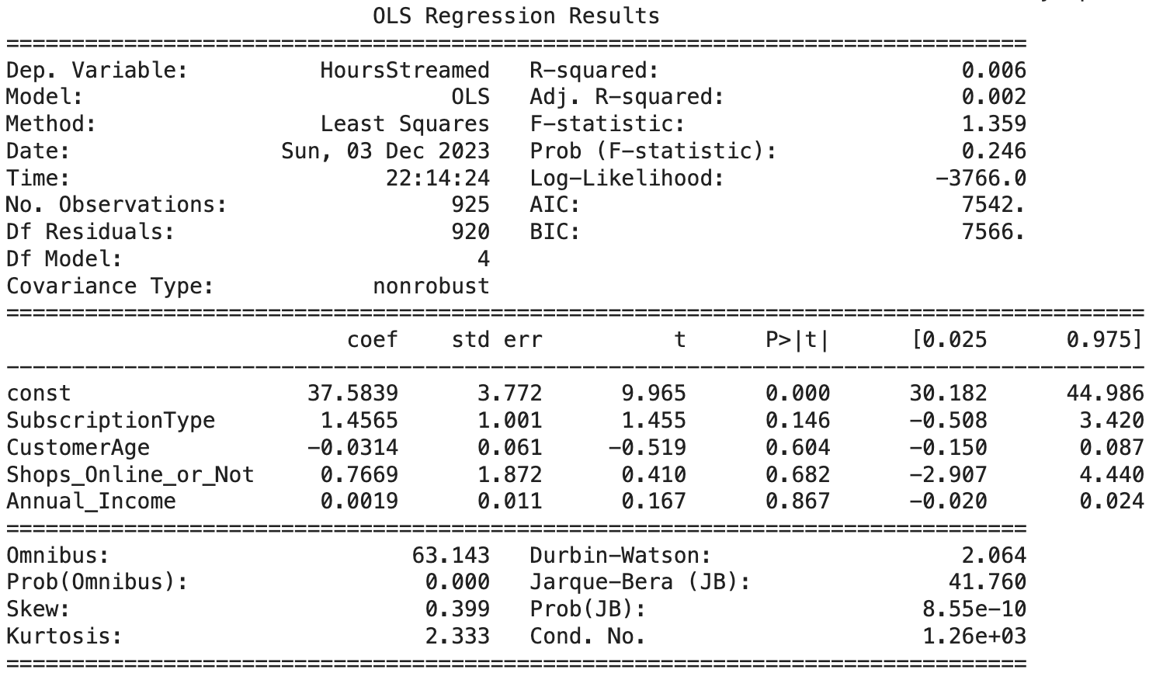
Regression Analysis
How does Subscription Type influence Hours Streamed?
NOT Statistically Significant
Users with NO ads are likely to stream 1.46 more hours

Slide 19
Conditional Average Treatment Effect
Conditional on: Shops Online or Not
Hypothesize that shopping online may influence user behavior
How does Subscription Type influence Hours Streamed?
CATE for user not shopping online = 0.56
CATE for user shopping online = 2.38
P-value = 0.11 → insignificant
Insight: users who shop online are likely to stream for more hours

Slide 20
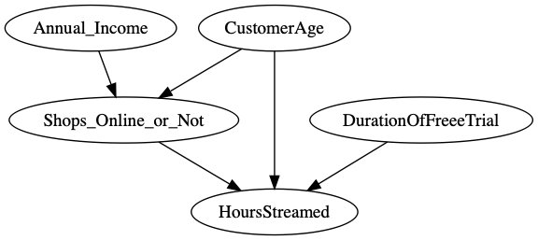
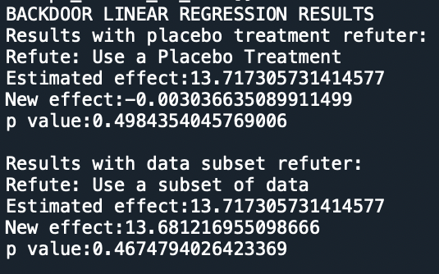
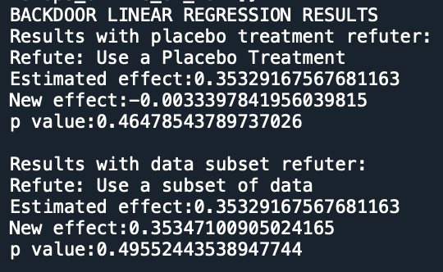
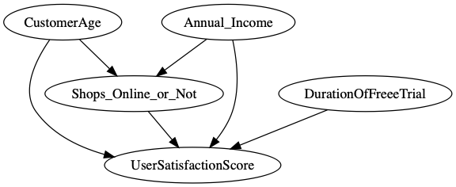
DoWhy Analysis
Treatment: Duration of Free Trial
Outcome:
Hours Streamed
Treatment: Duration of Free Trial
Outcome:
User Satisfaction Score

Slide 21
Difference in Differences
We did NOT perform DiD
Reasons:
DiD assumes that the treatment effect is constant across all units and time periods. If treatment effects vary across units or over time, this assumption may not hold.
Our data set does NOT have a controlled set of variables → we don’t have a proper control to compare to our treatment
No time period in which we enacted a certain treatment on one group instead of another

Slide 22
05
Key Findings & Recommendations

Slide 23
Key Takeaways
Longer durations of free trials increases the conversion rate of renewals by about 21%.
Prior to our analysis we considered that a longer free trial could create customer fatigue with our platform’s content but this was not the case.
As customers have more time to engage with our content in the free trial period, they are more likely to become paying customers.
2) Streaming plans with ads may reduce total customer time streamed.
When ads run while they are streaming, they less likely to continue watching.
The ads themselves make up streaming streaming time. However, the effect of more watch time from ads is offsetted by negative effect of ads causing customers to stop watching.

Slide 24
Our Recommendations
We recommend our free trial strategy for new customers sets a duration for the free trial period of 11 or more days.
This more attractive trial period will drive customer engagement with our content and convert them into paying users.
This free trial period is longer than many competitors ( zero to seven days) and serves as a differentiating factor.
Our product team should be cautious with the use of ads and look for the ways to introduce them to customers in less obtrusive ways.

Slide 25
Future Steps
In the future, our team aims to conduct further analysis testing on the Duration of Free Trial for periods above 14 days as our data set and testing had a maximum of 14 days.
We will aim to find the exact number of days for the best customer renewal rates and overall satisfaction.
We also suggest conducting further analysis on the effect of ads on our consumer metrics.
Ideally, we would like to collect data across several different types of ads to optimize our ad strategy while maintaining customer engagement.

Slide 26
06
Thanks!
Any Questions?

